Slide 1

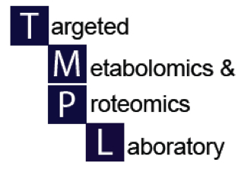

UAB Metabolomics Workshop
December 2, 2015
Processing of NMR-Metabolomics Data
N. Rama Krishna, Ph.D., Director
Central Alabama High-Field NMR Facility

Slide 2
Acknowledgments:
We thank Wimal Pathmasiri and Rodney Snyder of RTI International for permission to use their slides

Slide 3

NMR Based Metabolomics Analysis
RTI International
NMR Spectroscopy
  A robust, reliable, and highly reproducible technique in metabolomics analysis
  Quantitative and non-destructive method
  Most labs use 600 – 950 MHz Spectrometers
  The higher the field strength, the higher the sensitivity and resolution
Broad-spectrum metabolomics (or untargeted metabolomics)
  NMR binning (high throughput)
Targeted metabolomics
  Metabolite profiling and quantification of selected metabolites or a panel of metabolites
Wimal Pathmasiri & Rodney Snyder

Slide 4
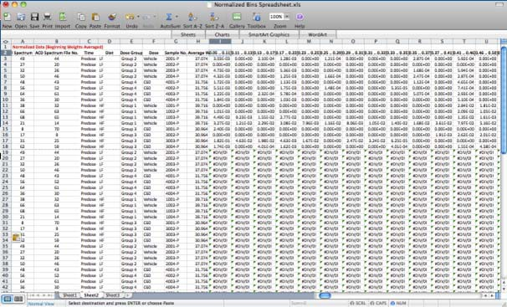
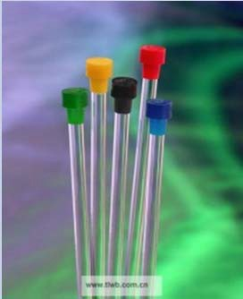
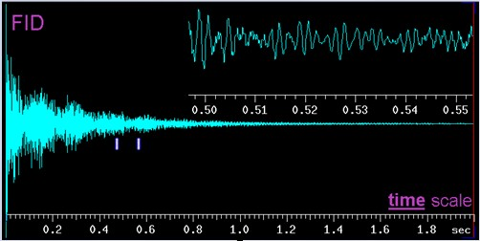













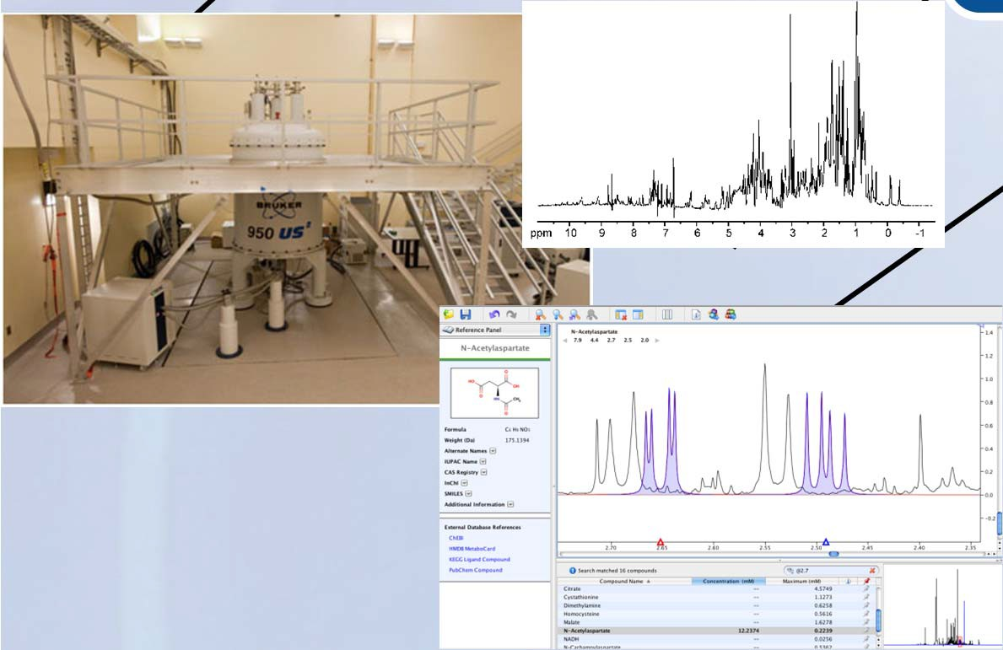
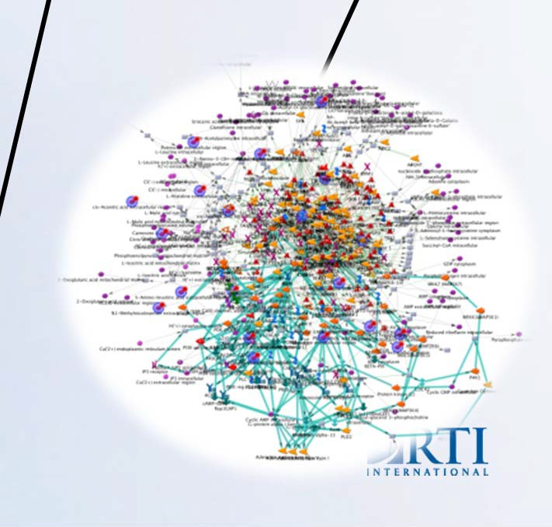
NMR Metabolomics Workflow
RTI International
Peak Alignment QC Check
Binned NMR
Data
Sample Preparation
NMR
Data Acquisition
Raw NMR data
(FID)
Fourier Transform Phase and Baseline Correction
Processed NMR Spectrum
1r, cnx, esp, jdx
Multivariate Data Analysis
Statistical Analysis
Pathway Analysis
Library Matched
Data
Scores Comp[1] vs. Comp[2] colored by Condition
40
30
20
Female
t[2]
10
NIST
Pooled
0
-10
-20
Males
-30
NMR data acquisition is performed by using methods cited in Beckonert et al. (2007), Nature Protocols, 2 (11), 2692‐2703.
-40
-50 -40 -30 -20 -10 0 10 20 30 40 50 t[1]

Slide 5
NMR Data
RTI International
A typical ¹H NMR Spectrum consists of thousands of sharp lines or signals.
The intensity of the peak is directly related to the number of protons underlying the peak.
The position of a particular peak in the X-axis of the NMR spectrum is called the “Chemical Shift” and it is
measured in ppm scale
The NMR spectrum obtained for the biological sample is referenced using a reference compound such as DSS, TSP, or Formate added to the sample in sample preparation step.
pH indicator may also be used (for example, Imidazole)
Wimal Pathmasiri & Rodney Snyder

Slide 6
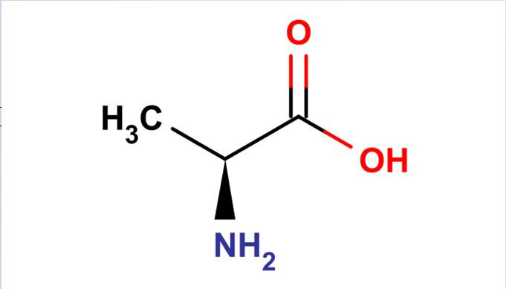
RTI International
anine.esp
B (three protons)
1.0
¹H NMR Spectrum for alanine
Al
O
1
H 2 _{O}
6a ₃
H ⁶ ⁴ H H
6b 4a 3a
_{H} N H
_{6c} 5 5b
H
5a
Peak position is called “chemical shift”
0.9
B
0.8
A
It depends on the chemical environment (pH dependent)
0.7
Normalized Intensity
0.6
Alanine
Splitting of peak is dependent on neighboring ¹H atom(s)
0.5
0.4
Area under peak proportional to the number of ¹H atoms underlying it
0.3
A (one proton)
0.2
0.1
4.0
3.5
3.0
2.5
2.0
Chemical Shift (ppm)
1.5
1.0
0.5
0
Chemical shift of CH 4 lines (quadrat)
Chemical shift of CH₃
2 lines (doublet)
Wimal Pathmasiri & Rodney Snyder

Slide 7
Typical ¹H NMR Spectrum of urine
RTI International
0.16
cfsup01d1.001.1r.esp
DSS (chemical shift reference)
0.15
0.14
0.13
0.12
0.11
0.10
0.09
0.08
0.07
0.06
0.05
0.04
0.03
0.02
0.01
Imidazole (pH reference)
Normalized Intensity
9
8
7
6
5
Chemical Shift (ppm)
4
3
2
1
0
Wimal Pathmasiri & Rodney Snyder

Slide 8
RTI International
Broad Spectrum Metabolomics NMR Binning
Wimal Pathmasiri & Rodney Snyder

Slide 9
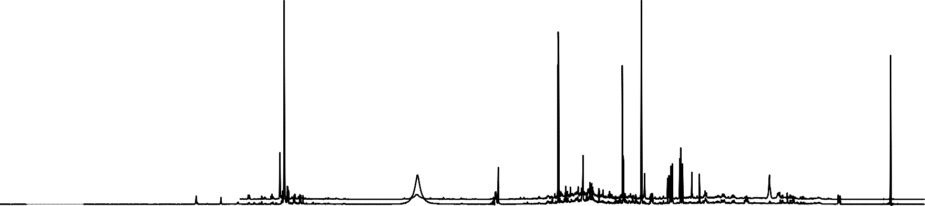
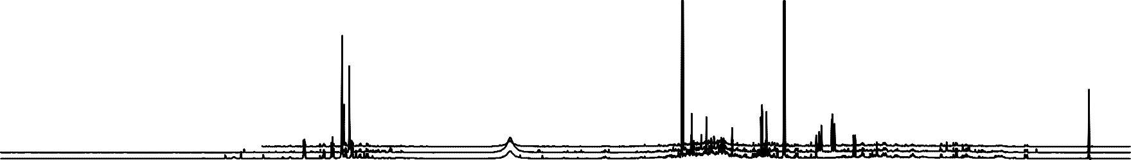
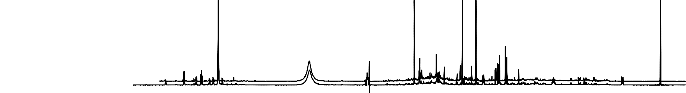
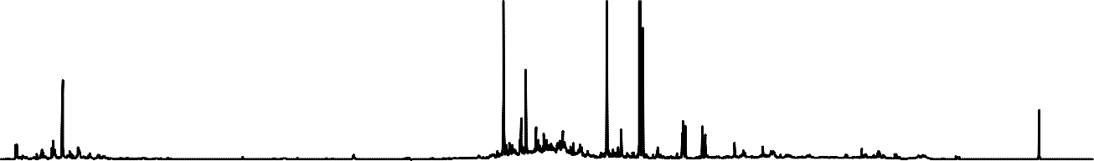
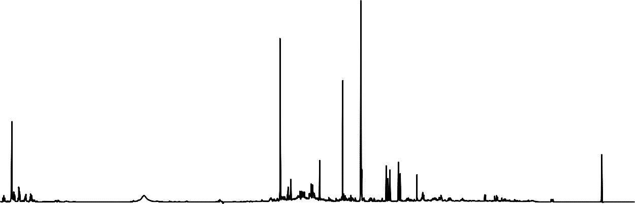
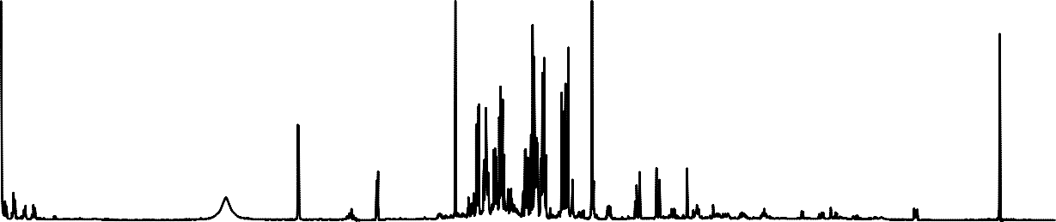
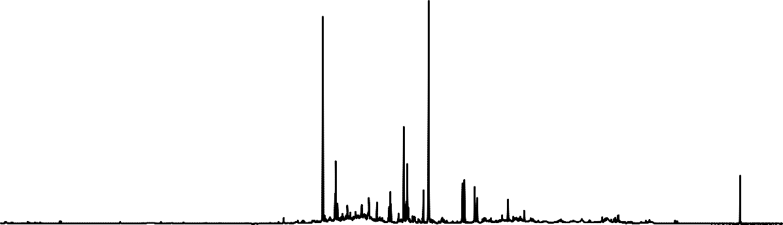
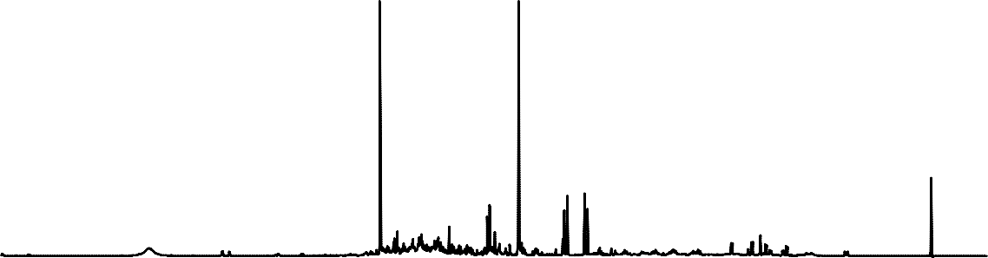
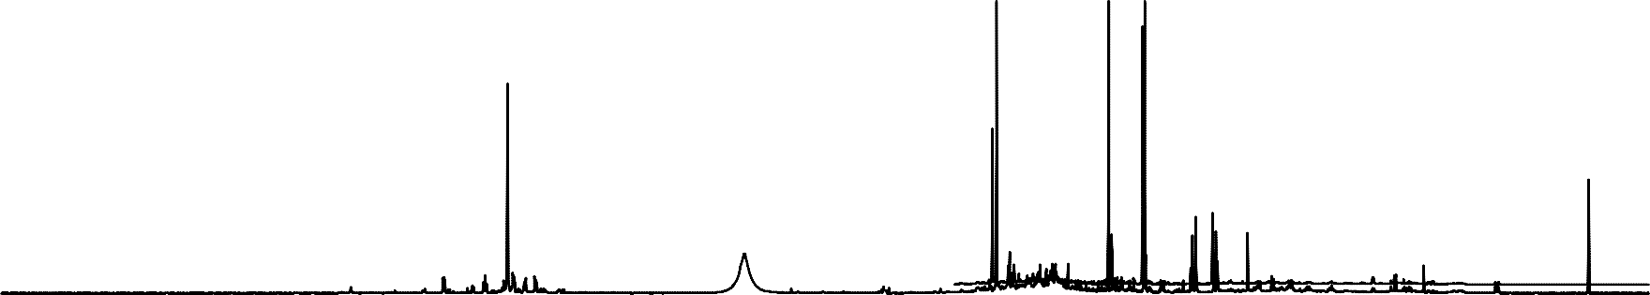
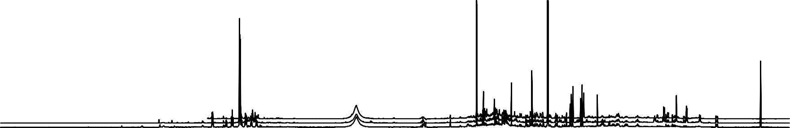
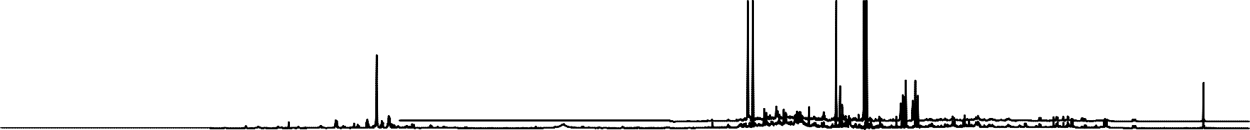
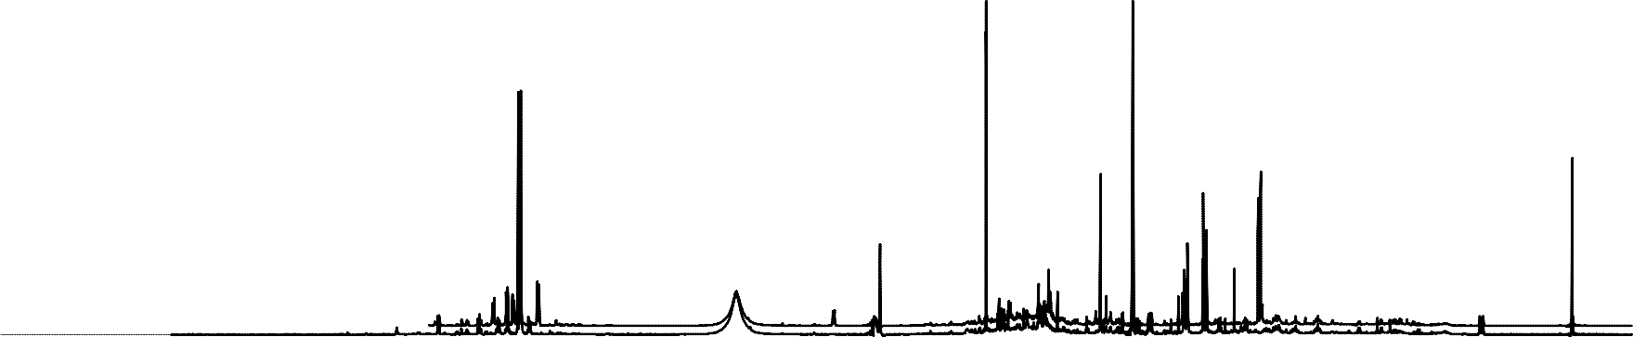
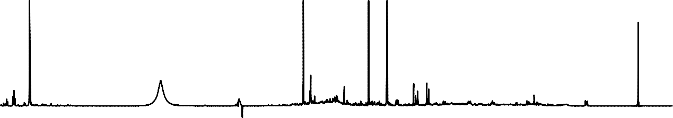
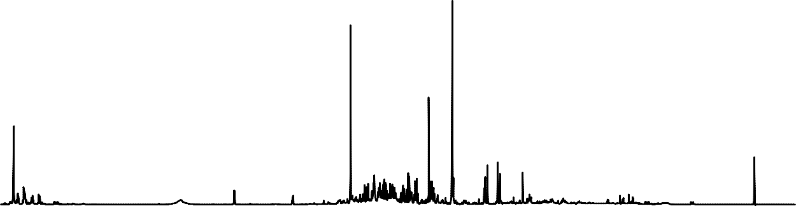
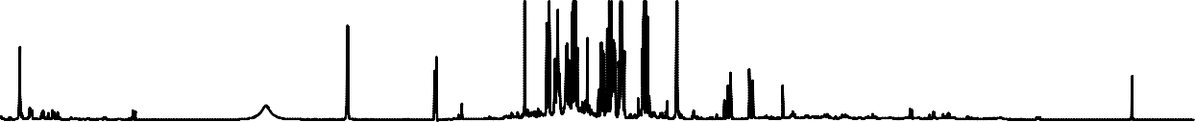
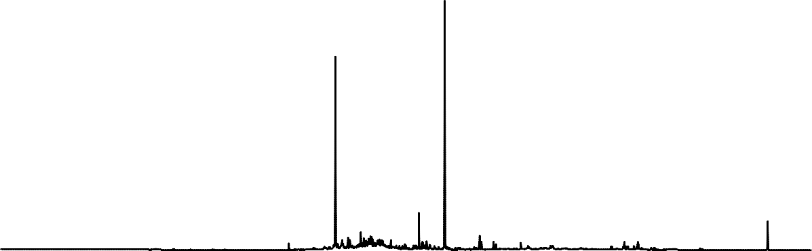
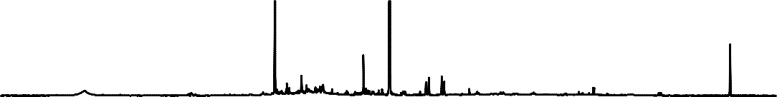
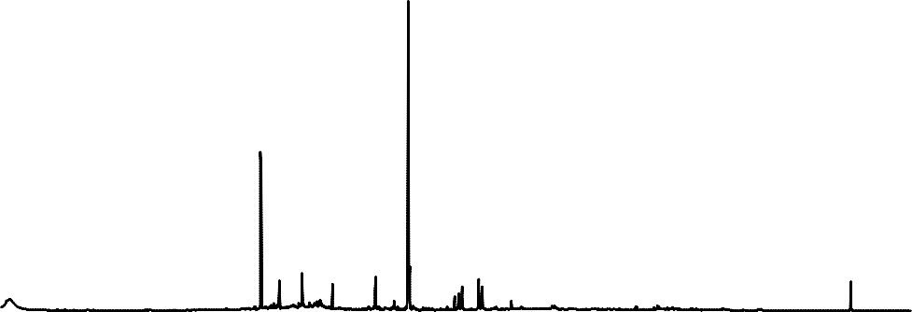
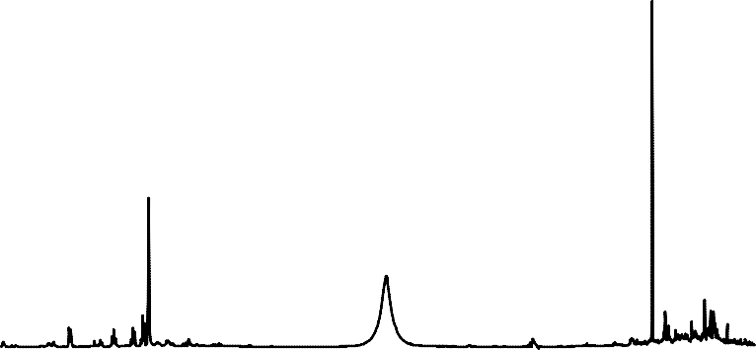
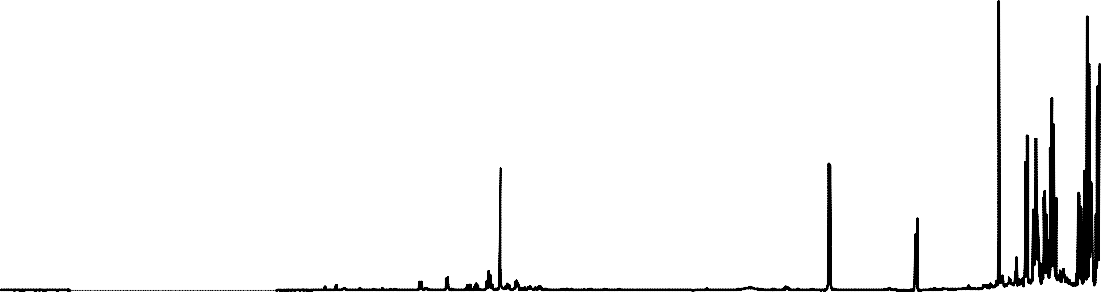
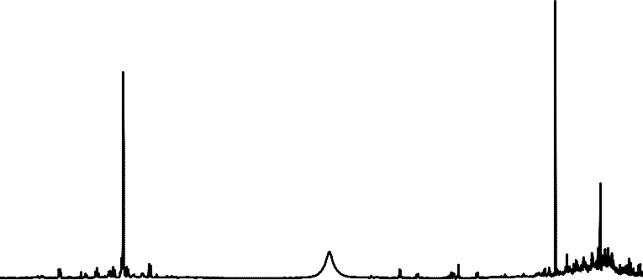
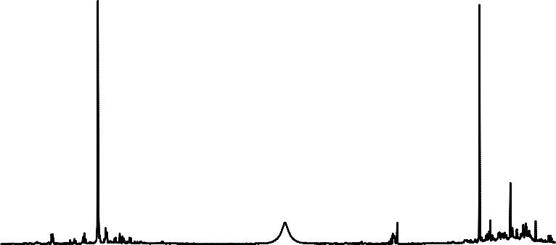
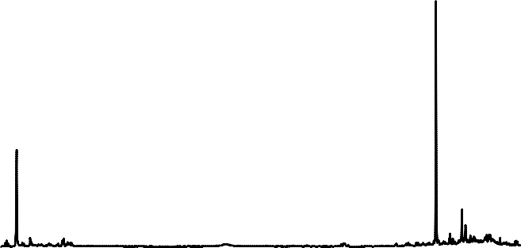
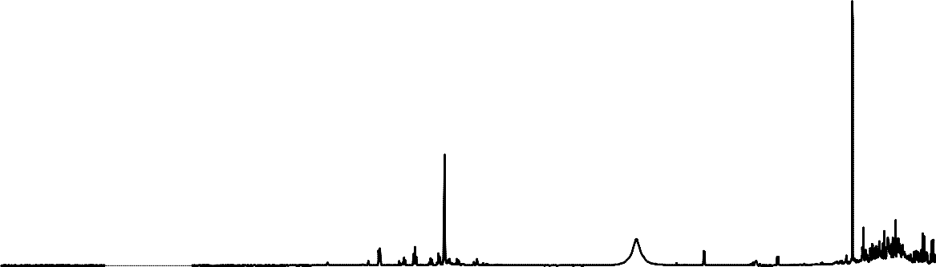
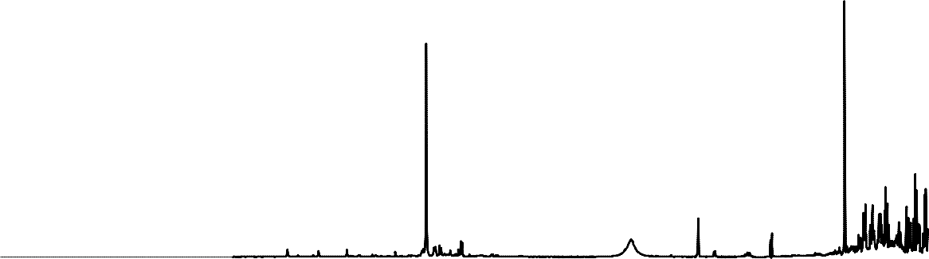
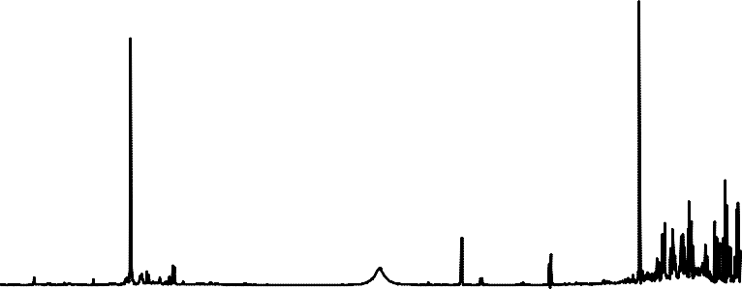
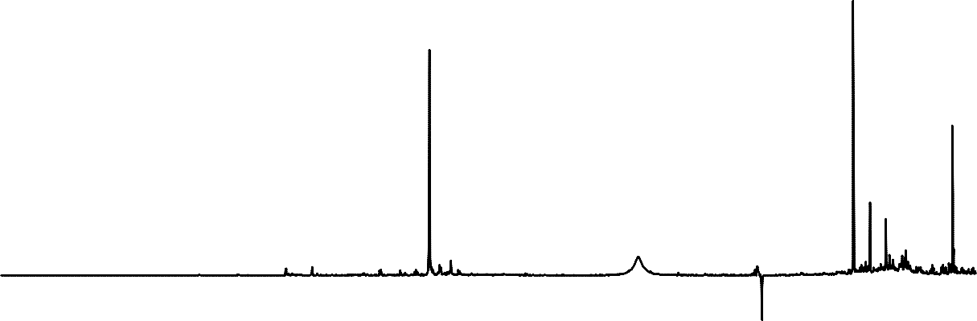
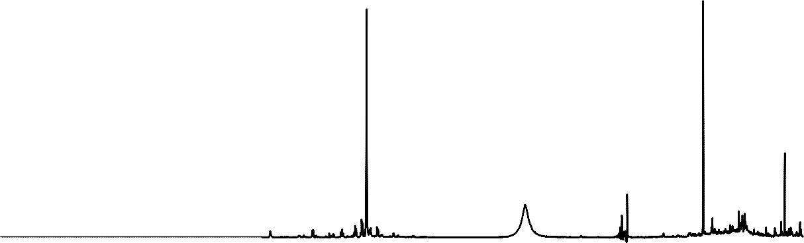
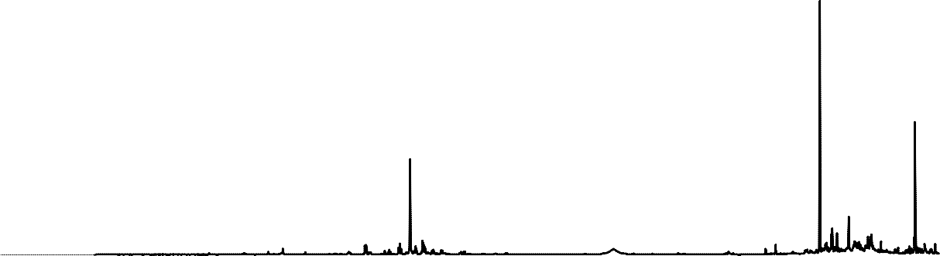
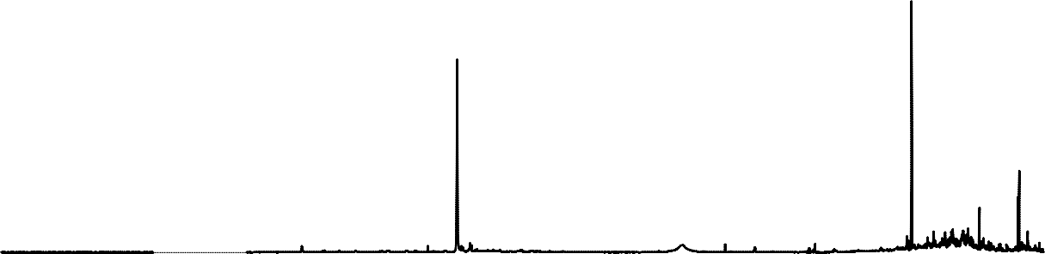
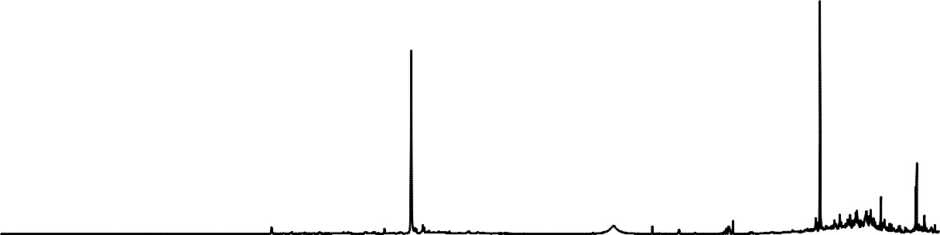
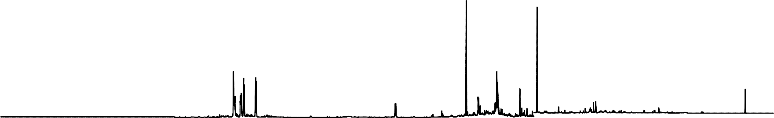
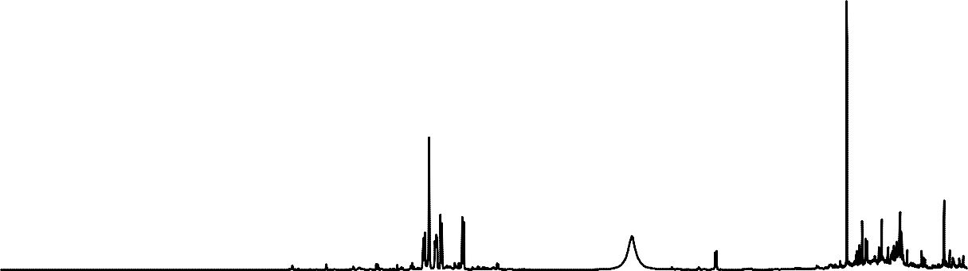
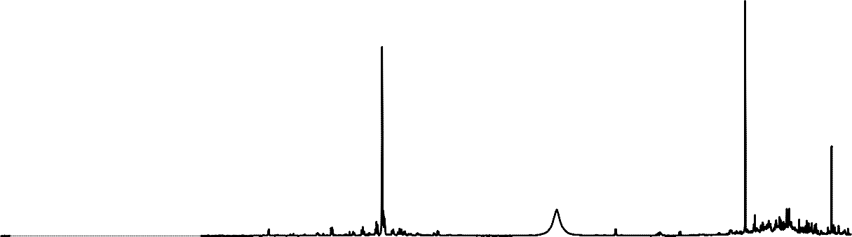
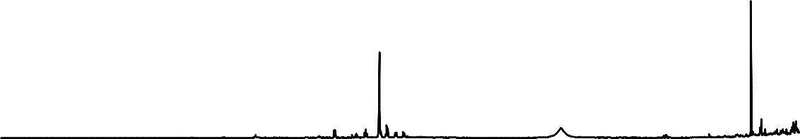
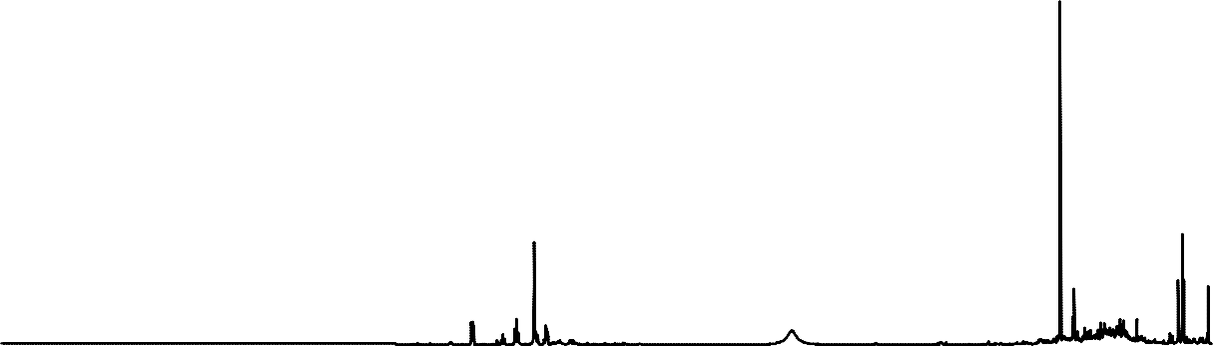
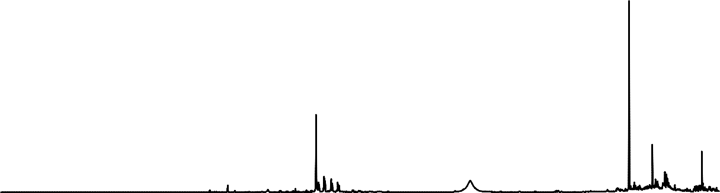
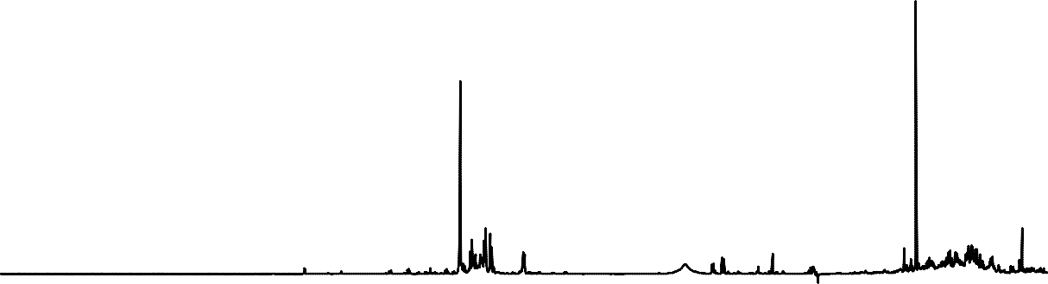
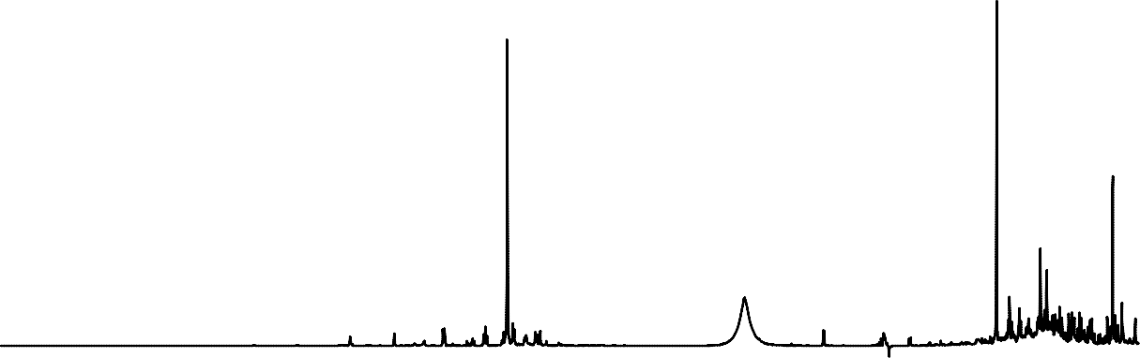
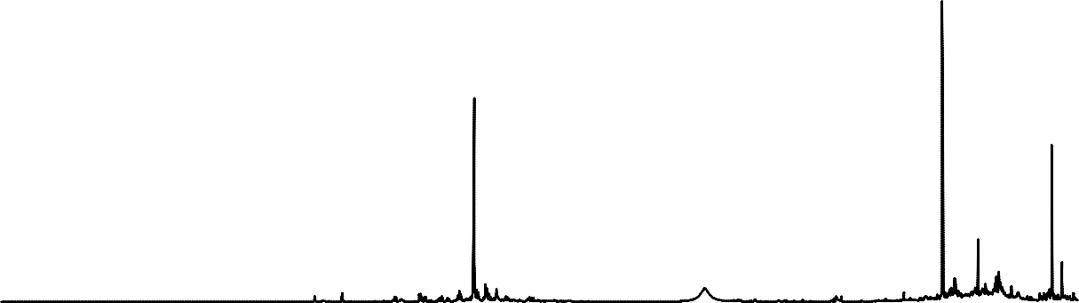
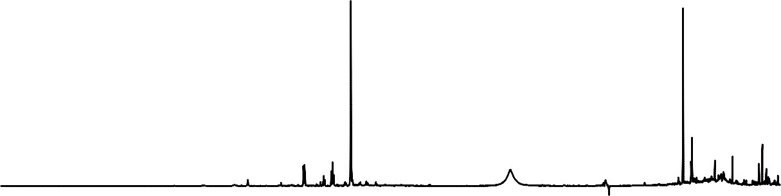
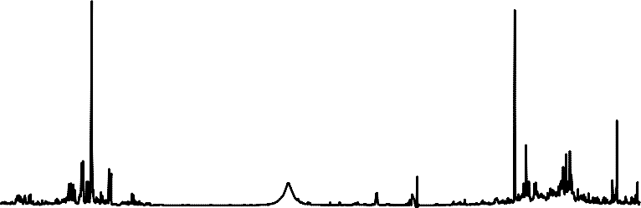
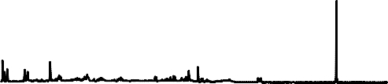

















































Binning
RTI International
PETROVIC_SPECTRA_OVERLAYED.
QC.
WP.12.04.2013.ESP
Samples
1.0
Normalized Intensity
0.5
0
-0.5
10
9
8
7
6 5
Chemical Shift (ppm)
4
3
2
1
0
Wimal Pathmasiri & Rodney Snyder

Slide 10






















































































Remove regions
RTI International
Downfield region
DSS and up field
Urea Water
PETROVIC_SPECTRA_OVERLAYED.
QC.
WP.12.04.2013.ESP
1.0
Normalized Intensity
0.5
0
-0.5
10
9
8
7
6 5
Chemical Shift (ppm)
4
3
2
1
0
Bins
Wimal Pathmasiri & Rodney Snyder

Slide 11

Binning
RTI International
Integrate bins (0.04 ppm bin size)
Normalize bins to the total integral of each spectrum
Merge metadata
▪
Result is a spreadsheet ready for further multivariate data analysis and other statistical analysis
Sample ID | Disease Group | [0.40 .. 0.46] | [0.46 .. 0.52] | [0.52 .. 0.54] | [0.54 .. 0.57] | [0.57 .. 0.60] | [0.60 .. 0.66] | [0.66 .. 0.68] | [0.68 .. 0.71] | [0.71 .. 0.75]
C0559 | Cases | 7.60E-05 | 0.00E+00 | 7.32E-02 | 8.48E-02 | 3.20E-02 | 1.84E+00 | 1.31E-01 | 3.60E-01 | 3.67E-01
C0629 | Cases | 0.00E+00 | 1.78E-02 | 0.00E+00 | 2.18E-02 | 0.00E+00 | 1.08E+01 | 0.00E+00 | 0.00E+00 | 3.02E-02
C0640 | Cases | 3.44E-04 | 0.00E+00 | 1.83E-03 | 1.86E-04 | 0.00E+00 | 4.51E+00 | 0.00E+00 | 0.00E+00 | 0.00E+00
C0835 | Cases | 6.41E-04 | 0.00E+00 | 6.44E-03 | 0.00E+00 | 3.96E-03 | 3.28E+00 | 0.00E+00 | 5.12E-03 | 1.75E-02
D0613 | Cases | 6.63E-03 | 0.00E+00 | 0.00E+00 | 1.06E-02 | 0.00E+00 | 5.79E+00 | 0.00E+00 | 6.36E-02 | 3.02E-01
D0762 | Cases | 0.00E+00 | 0.00E+00 | 1.79E-02 | 1.98E-02 | 0.00E+00 | 9.37E+00 | 0.00E+00 | 0.00E+00 | 1.74E-02
D1113 | Cases | 3.14E-03 | 2.42E-03 | 8.02E-02 | 1.04E-01 | 5.32E-03 | 3.74E+00 | 0.00E+00 | 2.02E-02 | 1.84E-01
D1158 | Cases | 0.00E+00 | 3.71E-03 | 2.35E-02 | 4.83E-02 | 0.00E+00 | 5.02E+00 | 0.00E+00 | 1.91E-02 | 0.00E+00
D2090 | Cases | 0.00E+00 | 0.00E+00 | 2.45E-03 | 9.98E-04 | 0.00E+00 | 5.76E+00 | 0.00E+00 | 1.24E-02 | 1.04E-02
E0004 | Cases | 1.72E-03 | 0.00E+00 | 6.85E-02 | 3.05E-02 | 0.00E+00 | 1.47E+00 | 6.90E-02 | 3.61E-01 | 4.08E-01
E0195 | Cases | 0.00E+00 | 1.69E-03 | 5.57E-02 | 6.29E-02 | 0.00E+00 | 2.77E+00 | 1.34E-01 | 2.04E-01 | 4.56E-01
E0225 | Cases | 1.25E-03 | 0.00E+00 | 4.40E-03 | 1.69E-02 | 0.00E+00 | 9.17E+00 | 0.00E+00 | 1.08E-02 | 2.30E-02
E0309 | Cases | 4.11E-03 | 0.00E+00 | 2.23E-02 | 7.54E-03 | 3.08E-03 | 3.54E+00 | 0.00E+00 | 3.28E-02 | 9.09E-01
E0487 | Cases | 1.72E-03 | 0.00E+00 | 0.00E+00 | 1.00E-02 | 0.00E+00 | 4.00E+00 | 0.00E+00 | 1.36E-02 | 0.00E+00
F0036 | Cases | 1.66E-02 | 0.00E+00 | 0.00E+00 | 2.06E-02 | 0.00E+00 | 1.22E+01 | 1.04E-02 | 0.00E+00 | 5.97E-01
F0108 | Cases | 0.00E+00 | 2.31E-03 | 6.30E-03 | 1.11E-02 | 0.00E+00 | 7.17E+00 | 0.00E+00 | 1.65E-02 | 2.21E-01
A0233 | Control | 0.00E+00 | 1.86E-02 | 0.00E+00 | 1.82E-02 | 0.00E+00 | 1.61E+01 | 0.00E+00 | 2.91E-03 | 0.00E+00
A0490 | Control | 0.00E+00 | 0.00E+00 | 2.99E-03 | 3.60E-02 | 0.00E+00 | 2.97E+00 | 0.00E+00 | 4.00E-02 | 5.46E-01
A2003 | Control | 0.00E+00 | 0.00E+00 | 3.45E-02 | 2.20E-02 | 0.00E+00 | 1.80E+00 | 0.00E+00 | 0.00E+00 | 0.00E+00
C0586 | Control | 0.00E+00 | 1.69E-02 | 0.00E+00 | 6.64E-03 | 0.00E+00 | 1.92E+01 | 0.00E+00 | 6.51E-02 | 0.00E+00
C2177 | Control | 0.00E+00 | 0.00E+00 | 3.02E-02 | 3.59E-02 | 0.00E+00 | 2.35E+00 | 0.00E+00 | 3.19E-02 | 1.49E-01
D0177 | Control | 9.21E-03 | 0.00E+00 | 1.69E-02 | 1.47E-02 | 0.00E+00 | 2.43E+00 | 0.00E+00 | 4.46E-02 | 0.00E+00
D0729 | Control | 0.00E+00 | 1.88E-03 | 5.58E-02 | 7.87E-02 | 2.92E-02 | 3.16E+00 | 6.59E-02 | 2.80E-01 | 4.30E-01
D0909 | Control | 0.00E+00 | 1.08E-03 | 0.00E+00 | 5.69E-03 | 0.00E+00 | 2.49E+00 | 0.00E+00 | 1.01E-02 | 1.87E-01
D0945 | Control | 0.00E+00 | 4.79E-04 | 7.00E-03 | 0.00E+00 | 4.19E-03 | 3.99E+00 | 0.00E+00 | 1.11E-03 | 3.96E-02
D1174 | Control | 0.00E+00 | 9.33E-04 | 0.00E+00 | 3.43E-03 | 1.30E-02 | 7.21E+00 | 6.53E-03 | 0.00E+00 | 1.66E-02
D2054 | Control | 1.55E-03 | 0.00E+00 | 0.00E+00 | 1.22E-02 | 0.00E+00 | 2.07E+00 | 0.00E+00 | 1.28E-02 | 3.90E-01
D2062 | Control | 2.39E-05 | 0.00E+00 | 6.04E-02 | 2.99E-02 | 0.00E+00 | 4.94E+00 | 0.00E+00 | 9.95E-03 | 0.00E+00
D2079 | Control | 2.73E-02 | 0.00E+00 | 1.81E-03 | 1.17E-02 | 0.00E+00 | 3.38E+01 | 7.87E-02 | 0.00E+00 | 5.91E+00
Wimal Pathmasiri & Rodney Snyder

Slide 12
RTI International
Multivariate Data Analysis & Other Statistical Analysis
Wimal Pathmasiri & Rodney Snyder

Slide 13





















































Multivariate data analysis and other statistical analyses
RTI International
Mean centered and scaled data
Non-supervised analysis
  Principal component analysis (PCA)
Supervised analysis
  PLS-DA and OPLS-DA
Loadings plots and VIP Plots to identify discriminatory bins
p-Value, fold change
PCA
VIP Plot
VIP[1]
OPLS-DA
3.03
4.04
2.58
2.46
2.60
4.12
1.48
4.03
7.55
4.34
3.15
3.41
3.79
4.33
4.18
7.63
4.35
4.31
1.22
8.12
3.84
Wimal Pathmasiri & Rodney Snyder

Slide 14
RTI International
Library Matching
(and quantifying) Using Chenomx
Wimal Pathmasiri & Rodney Snyder

Slide 15
Chenomx Library
RTI International
1,3-Dihydroxyacetone, 1,3-Dimethylurate, 1,6-Anhydro-β-D-glucose, 1,7-Dimethylxanthine, 1-Methylnicotinamide, 2'- Deoxyadenosine, 2'-Deoxyguanosine, 2'-Deoxyinosine, 2-Aminoadipate, 2-Aminobutyrate, 2-Ethylacrylate, 2-Furoate, 2- Hydroxy-3-methylvalerate, 2-Hydroxybutyrate, 2-Hydroxyglutarate, 2-Hydroxyisobutyrate, 2-Hydroxyisocaproate, 2- Hydroxyisovalerate, 2-Hydroxyphenylacetate, 2-Hydroxyvalerate, 2-Methylglutarate, 2-Octenoate, 2-Oxobutyrate, 2-
Oxocaproat▪e, 2-O_{O}xog_{v}lu_{e}ta_{r}rat₃e, ₂2-O₀xoi_{m}soca_{e}pr_{t}o_{a}at_{b}e, _{o}2-O_{li}x_{t}o_{e}va_{s}lerate, 2-Phosphoglycerate, 3,4-Dihydroxymandelate, 3,5-
Dibromotyrosine, 3-Aminoisobutyrate, 3-Chlorotyrosine, 3-Hydroxy-3-methylglutarate, 3-Hydroxybutyrate, 3- Hydroxyisovalerate, 3-Hydroxymandelate, 3-Hydroxyphenylacetate, 3-Indoxylsulfate, 3-Methyl-2-oxovalerate, 3- Methyladipate, 3-Methylxanthine, 3-Phenyllactate, 3-Phenylpropionate, 4-Aminobutyrate, 4-Aminohippurate, 4-Hydroxy-3-
methoxyma▪ndela_{p}te_{H}, 4-H_{s}yd_{e}ro_{n}xyb_{s}e_{i}n_{t}z_{i}o_{v}ate_{e}, 4_{l}-H_{ib}yd_{r}ro_{a}xy_{r}b_{y}utyr_{o}ate_{f}, ₁4-H_{H}ydro_{N}xyp_{M}hen_{R}ylac_{S}eta_{p}te_{e}, 4_{c}-H_{t}y_{r}dr_{a}oxyphenyllactate, 4-
Pyridoxate, 5,6-Dihydrothymine, 5,6-Dihydrouracil, 5-Aminolevulinate, 5-Hydroxyindole-3-acetate, 5-Hydroxylysine, 5- Methoxysalicylate, Acetaldehyde, Acetamide, Acetaminophen, Acetate, Acetoacetate, Acetone, Acetylsalicylate, Adenine, Adenosine, Adipate, Alanine, Allantoin, Alloisoleucine, Anserine, Arginine, Argininosuccinate, Asparagine, Aspartate,
Benzoate, B▪etain_{C}e, B_{u}io_{s}tin_{t},_{o}Bu_{m}tan_{i}o_{z}ne_{a}, B_{b}ut_{l}y_{e}rate, Caffeine, Caprate, Caprylate, Carnitine, Carnosine, Choline, Cinnamate,
Citrate, Citrulline, Creatine, Creatinine, Cysteine, Cystine, Cytidine, Cytosine, DSS (Chemical Shift Indicator), Dimethylamine, Epicatechin, Ethanol, Ethanolamine, Ethylene glycol, Ethylmalonate, Ferulate, Formate, Fructose, Fucose, Fumarate, Galactarate, Galactitol, Galactonate, Galactose, Gentisate, Glucarate, Glucose, Glutamate, Glutamine, Glutarate, Glutaric acid monomethyl ester, Glutathione, Glycerate, Glycerol, Glycine, Glycolate, Glycylproline, Guanidoacetate, Guanine, Hippurate, Histidine, Homocitrulline, Homocystine, Homogentisate, Homoserine, Homovanillate, Hypoxanthine, Ibuprofen, Imidazole, Indole-3-acetate, Inosine, Isobutyrate, Isocaproate, Isocitrate, Isoleucine, Isopropanol, Isovalerate, Kynurenate, Kynurenine, Lactate, Lactose, Leucine, Levulinate, Lysine, Malate, Maleate, Malonate, Mannitol, Mannose, Methanol, Methionine, Methylamine, Methylguanidine, Methylmalonate, Methylsuccinate, N,N-Dimethylformamide, N,N- Dimethylglycine, N-Acetylaspartate, N-Acetylglutamate, N-Acetylglycine, N-Carbamoyl-β-alanine, N-Carbamoylaspartate, N- Isovaleroylglycine, NAD+, Niacinamide, Nicotinate, O-Acetylcarnitine, O-Phosphocholine, O-Phosphoethanolamine, O- Phosphoserine, Ornithine, Oxalacetate, Oxypurinol, Pantothenate, Phenol, Phenylacetate, Phenylacetylglycine, Phenylalanine, Pimelate, Proline, Propionate, Propylene glycol, Protocatechuate, Pyridoxine, Pyroglutamate, Pyruvate, Quinolinate, Riboflavin, Ribose, S-Adenosylhomocysteine, S-Sulfocysteine, Salicylate, Salicylurate, Sarcosine, Serine, Suberate, Succinate, Succinylacetone, Sucrose, Tartrate, Taurine, Theophylline, Threonate, Threonine, Thymine, Thymol, Tiglylglycine, Trigonelline, Trimethylamine, Trimethylamine N-oxide, Tryptophan, Tyramine, Tyrosine, Uracil, Urea, Uridine, Urocanate, Valerate, Valine, Valproate, Vanillate, Xanthine, Xanthosine, Xylose, cis-Aconitate, myo-Inositol, o-Cresol, p- Cresol, trans-4-Hydroxy-L-proline, trans-Aconitate, β-Alanine, π-Methylhistidine, τ-Methylhistidine
Wimal Pathmasiri & Rodney Snyder

Slide 16

NMR Spectrum of Urine with Chenomx Library Fit of Metabolites
RTI International
Wimal Pathmasiri & Rodney Snyder

Slide 17

Fitting of metabolites
RTI International
Wimal Pathmasiri & Rodney Snyder

Slide 18

Fitting taurine
RTI International
Taurine
1.03 mM
Wimal Pathmasiri & Rodney Snyder

Slide 19


Fitting fucose
RTI International
Fucose
0.47 mM
Wimal Pathmasiri & Rodney Snyder

Slide 20


Additive Fit
RTI International
Wimal Pathmasiri & Rodney Snyder

Slide 21

Chenomx Helps Resolving Ambiguity in Highly Overlapped Regions
RTI International
Wimal Pathmasiri & Rodney Snyder

Slide 22

Additive fit
RTI International
Wimal Pathmasiri & Rodney Snyder

Slide 23
RTI International
Interpretation & Metabolic Pathway Analysis
Wimal Pathmasiri & Rodney Snyder

Slide 24
Interpreting results and Pathway Analysis
RTI International
Once we have performed a metabolomics analysis,
We find some important metabolites that are responsible for the separation of study groups.
The next question is “What it means?
How do you correlate these finding to your study questions?
Does it explain any findings that are meaningful for your study hypotheses?
Does it generate a new hypothesis?
How do you answer these questions?
Next step is to interpret results and metabolic pathway analysis
Wimal Pathmasiri & Rodney Snyder

Slide 25
Interpreting results and Pathway Analysis
RTI International
There is a number of freely available software
o meta-P Server, Metaboanalyst, Met-PA, web based KEGG Pathways.
Another way of interpreting metabolomics results is to use traditional biochemistry text books.
The input for pathway analysis is typically a list of metabolites (with any fold change or p-value information)
Genomics, transcriptomics, and/or proteomics data can be integrated
Once these pathways are identified, you may perform a targeted metabolomics analysis to validate the findings from global analysis.
Wimal Pathmasiri & Rodney Snyder

Slide 26
Day 0 serum- Predicting Day 28 Response to Vaccine
RTI International
PLS-DA
Day 0 – High Responders (Black)
vs Low Responders (Red)
Subset of Metabolites that Influence the Separation of Subjects at Day 0 (VIP ≥ 1 or p-value ≤ 0.1)
Isoleucine** | Creatinine**
Leucine** | Cysteine**
Valine | Histidine
3-Methyl-2-oxo-isovalerate | Choline
3-Hydroxybutyrate | Glucose
Lactate | Betaine
Alanine | TMAO
Acetate** | Glycine
Proline* | Glycerol
Glutamate** | Serine
Glutamine** | Creatine
Pyruvate | Tyrosine*
2-Oxoisocaproate | Histidine
Methylguanidine** | Tryptophan
Formate | Phenylalanine
PopGen_BinningResults_Regions_Removed.01.09.2013.M3 (PLS-DA), Day 0 All Subjects t[Comp. 1]/t[Comp. 2]
Colored according to classes in M3
high low
10
9
8
7
6
5
4
3
2
1
0
-1
-2
-3
-4
-5
-6
-7
-8
-9
-10
t[2]
-13 -12 -11 -10 -9 -8 -7 -6 -5 -4
-3 -2 -1 0 1 2 3 4 5 t[1]
6 7 8 9
Preliminary results
R2X[1] = 0.130952
Ellipse: Hotelling T2 (0.95)
R2X[2] = 0.112839
SIMCA-P+ 12.0.1 - 2013-01-18 15:22:47 (UTC-5)
*p-value < 0.05, **p-value ≤ 0.1
Wimal Pathmasiri & Rodney Snyder

Slide 27
Some Software available for NMR Based Metabolomics
RTI International
COMMERCIAL
NMR Data-preprocessing
  ACD Software (ACD Labs, Toronto, Canada)
  Chenomx
Multivariate data analysis
  SIMCA 13
Other statistical analysis
  SAS, SPSS
Library matching and quantification
  Chenomx
Pathway analysis
  GeneGo (MetaCore Module)
  Ingenuity Pathway Analysis (IPA)
Wimal Pathmasiri & Rodney Snyder

